Slide 1

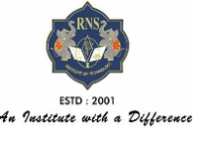

RNS INSTITUTE OF TECHNOLOGY
BENGALURU - 98
DEPARTMENT OF INFORMATION SCIENCE & ENGINEERING
Presentation on Internship
STUDENT ATTENDENCE MANAGEMENT SYSTEM
SHWETHA B
USN: 1RN18IS105
TechieAid
Internal Guide
Vinutha G K
Asst. Prof, Dept of ISE, RNSIT
External Guide
Mr. Ramesh Kumar
Techie Aid

Slide 2
AGENDA
Abstract
About the Company
Introduction
Requirements
System Design
Detailed Design
Implementation
Testing
Conclusion and Future Enhancement
References
Q & A

Slide 3
ABOUT THE COMPANY
TechieAid is the IT services company registered under Govt. of India, Ministry of Micro, Small & Medium Enterprises.
They offer IT Staffing Solutions, Technology Trainings, Leadership & Soft Skills Training, Software Development Services and Coaching & Mentoring.
Their clients are reputed MNC companies and leading academic institutions.
Their Mission is to empower their customers with necessary knowledge, skills and resources for them to succeed in their endeavors.

Slide 4
ABSTRACT
Student Attendance management system is important to every single organization, it can decide whether or not an organization such as educational institutions, public or private Sectors will be successful in the future.
Organizations will have to keep a track of people within the organization such as employees and students to maximize their performance.
Managing student attendance during lecture periods has become a difficult challenge.
The ability to compute the attendance percentage becomes a major task as manual computation produces errors, and wastes a lot of time.
For the stated reason, an efficient Web-based application for attendance management system is designed to track student's activity in the class.

Slide 5
INTRODUCTION
The ability to compute the attendance percentage becomes a major task as manual computation produces errors, and wastes a lot of time. For the stated reason, an efficient Web-based application for attendance management system is designed to track student's activity in the class.
This application takes attendance electronically and the records of the attendance are storing in a database. MySQL used for the Application Database.
Student attendance management system deals with the maintenance of the student’s attendance details. It is generates the attendance of the student on basis of presence in class. It is maintained on the daily basis of their attendance. The staffs will be provided with the separate username & password to make the student’s status.

Slide 6
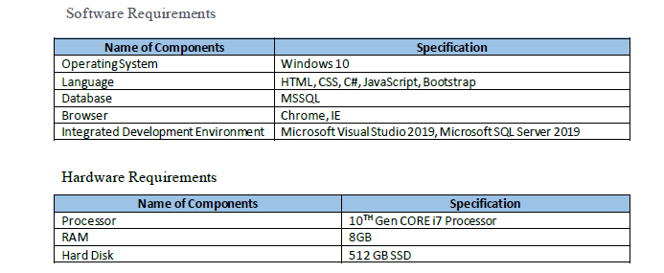
REQUIREMENTS

Slide 7
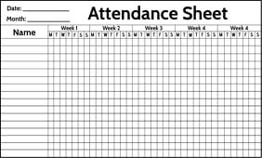
SYSTEM DESIGN
CURRENT DESIGN

Slide 8
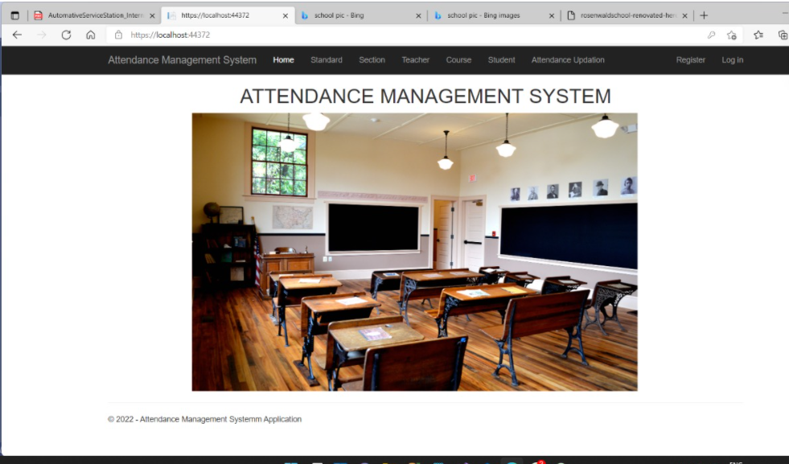
SYSTEM DESIGN
PROPOSED DESIGN:

Slide 9
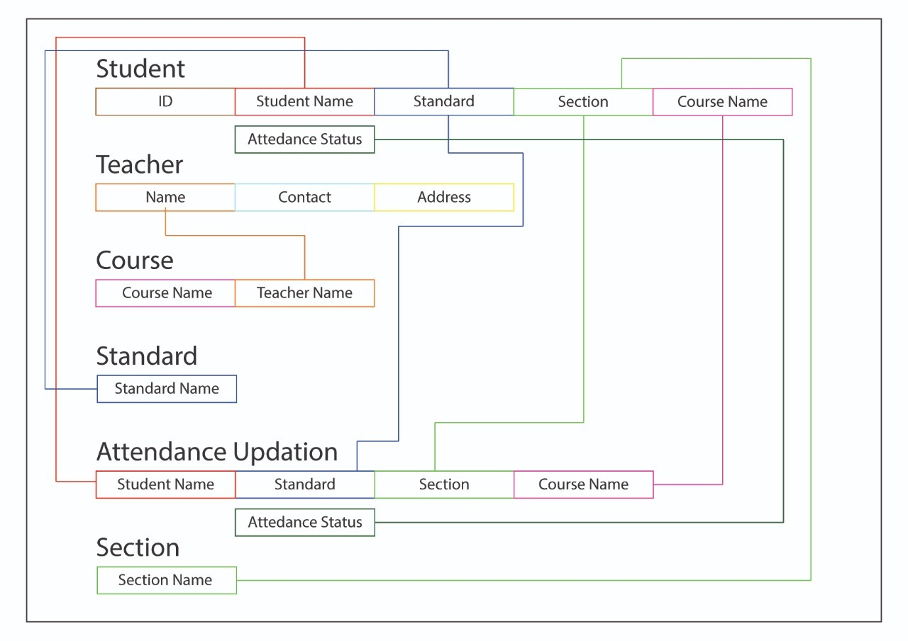
SYSTEM DESIGN
SCHEMA DIAGRAM:

Slide 10
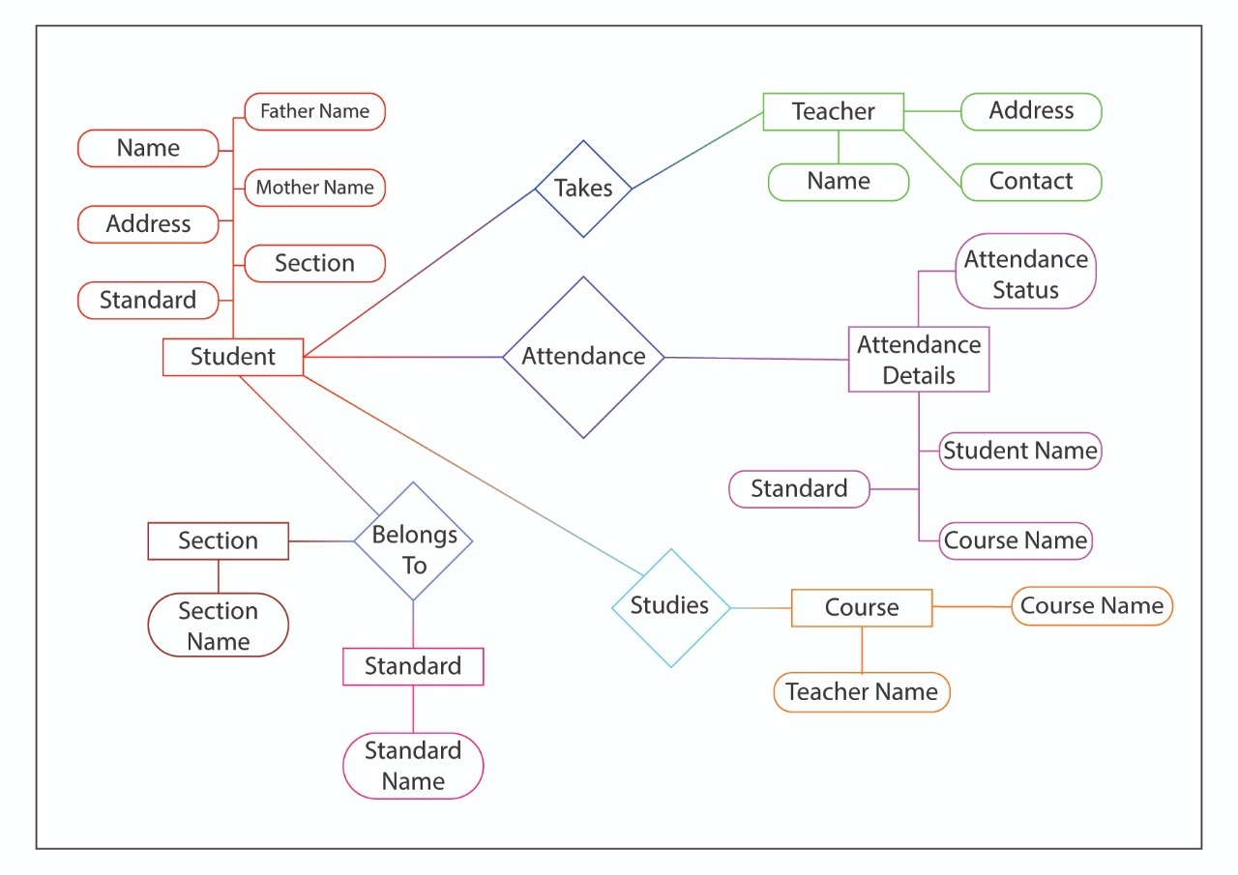
SYSTEM DESIGN
ER DIAGRAM:

Slide 11

IMPLEMENTATION
Web Configuration: The below code defines the database connection string configuration
<connectionStrings>
<add name="DefaultConnection" connectionString="Data
Source=LAPTOP-HLB6GCBI\SQLEXPRESS;Initial
Catalog=AttendanceDB;Integrated Security=True"
providerName="System.Data.SqlClient" />
<add name="AttendanceContext" connectionString="Data
Source=LAPTOP-HLB6GCBI\SQLEXPRESS;Initial
Catalog=AttendanceDB;Integrated Security=True"
providerName="System.Data.SqlClient" />
</connectionStrings>

Slide 12

IMPLEMENTATION
Student: This snippet shows the student sub list.
using System;
using System.Collections.Generic;
using System.ComponentModel.DataAnnotations.Schema;
using System.Linq;
using System.Web;
namespace Attendance. Models
{
public class Student
{
public int id { get; set; }
public string Name { get; set; }
public string FatherName { get; set; }
public string MotherName { get; set; }
public string Address { get; set; }
[ForeignKey("std")]
public int? Standard { get; set; }
public Standard std { get; set;
public Standard std { get; set; }
[ForeignKey("sec")]
public int? Section { get; set; }
public Section sec { get; set; }}
}

Slide 13
IMPLEMENTATION
1. About­_cshtml: The defined methods fetch the data from the database for about us data
4. Contact_cshtml: The calls Editor For Template to display the contact from the database.
@{
ViewBag.Title = "Contact";
}
<h2>@ViewBag.Title.</h2>
<h3>@ViewBag.Message</h3>
<address>
One Microsoft Way<br />
Redmond, WA 98052-6399<br />
<abbr title="Phone">P:</abbr>
425.555.0100
</address>
<address>
<strong>Support:</strong> <a href="mailto:Support@example.com">Support@example.com</a><br />
<strong>Marketing:</strong> <a href="mailto:Marketing@example.com">Marketing@example.com</a>
</address>
@{
ViewBag.Title = "Home Page";
}
<style>
img {
margin-left:150px;
}
</style>
<h1><center>ATTENDANCE MANAGEMENT SYSTEM</center></h1>
<img src="~/img/att.jpg" width="800" height="500">

Slide 14
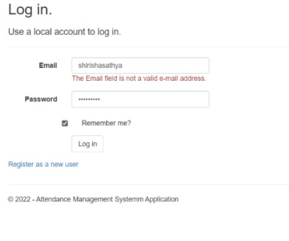
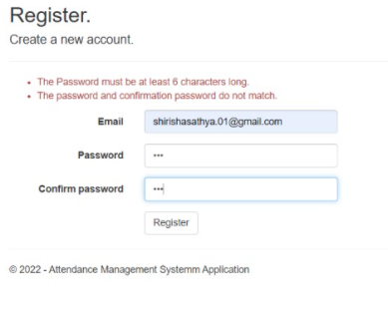
TESTING
1.Register Page:
This Figure shows the error message when the email is not in correct format.
This Figure shows the error message when the password entered is less than 8 characters .

Slide 15
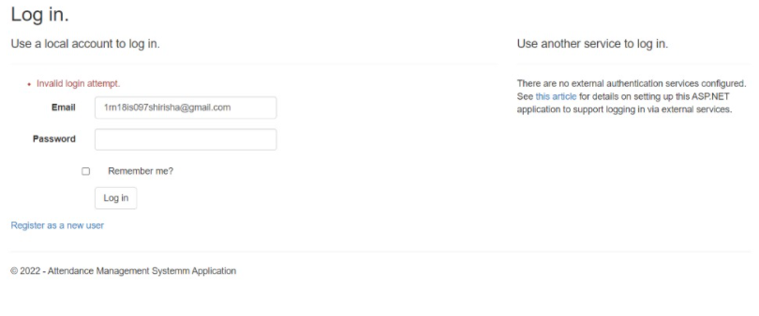
TESTING
2.Login Page:
This Figure shows the error message when the password is incorrect.

Slide 16
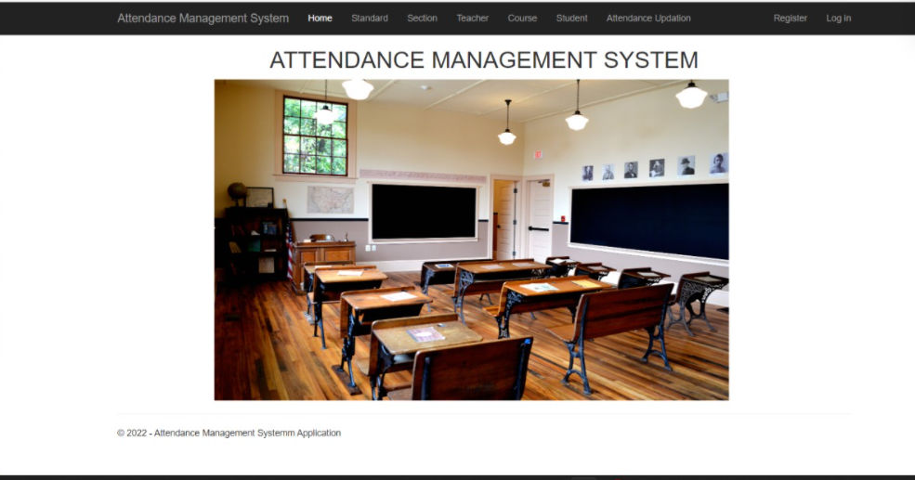
RESULTS
1.Home Page:
This SnapShot shows Home page.

Slide 17
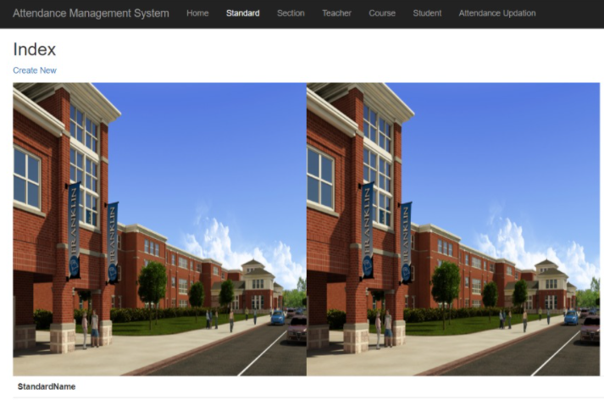
RESULTS
2.Standard Page:
Standard page

Slide 18
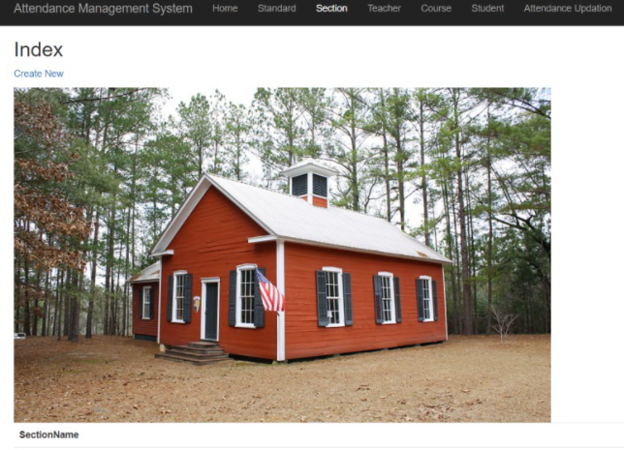
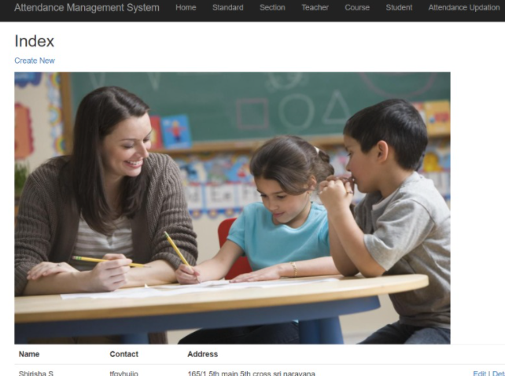
RESULTS
3.Sectionn Page: 4.Teacher’s details:

Slide 19
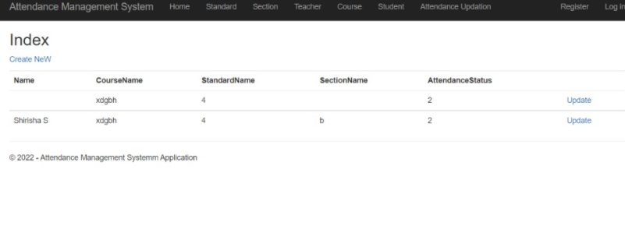
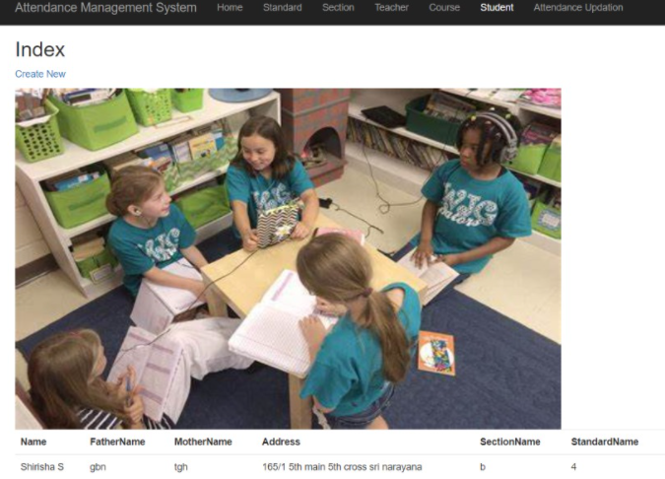
RESULTS
4.Course Details: 5.Student’s Details:

Slide 20
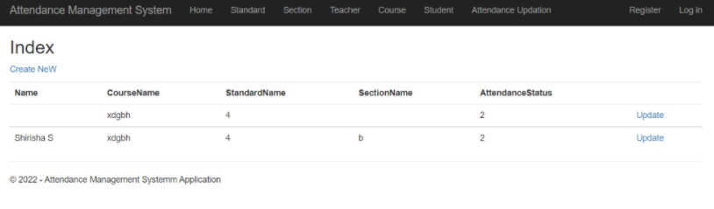
RESULTS
7.Attendance Status

Slide 21
CONCLUSION AND FUTURE ENHANCEMENT
A Computer can work more efficiently then compared to a human being. The work becomes easy for the employees and thus, some amount of human resources is saved. Data accuracy is maintained.
Scope for future development:-
The project has a very vast scope in future. The project can be implemented on intranet in future. Project can be updated in near future as and when requirement for the same arises, as it is very flexible in terms of expansion. With the propose software of database Space Manager ready and fully functional the client is now able to manage and hence run the entire work in a much better, accurate and error free manner. The following are the future scope for the project.
Bar code Reader based attendance system
Individual Attendance system with photo using Student login

Slide 22
REFERENCES
Microsoft Visual C# Step by Step (Developer Reference Edition)
Microsoft Visual C# Step by Step (Developer Reference Edition)Microsoft of Database Syst7th Edition.
Visual C# Step by Step (Developer Reference Editionbase Systems, Pearson, 7th Edition.
Learn SQL Tutorial - javatpoint
MS SQL Server Tutorial (tutorialspoint.com)
C# Tutorial - GeeksforGeeks
What is .NET Framework? Explain Architecture & Components (guru99.com)

Slide 23
THANK YOU

